Slide 1
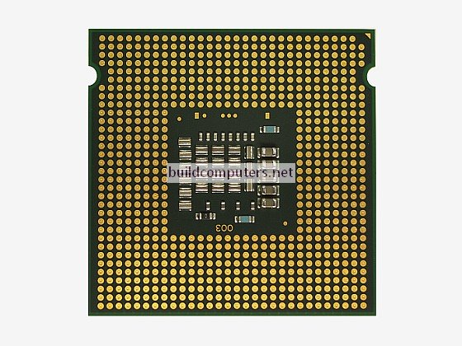
CPU
CPU is an Central Processing Unit
It performs the basic Arithmetical, logical and Input/Output operations of a computer system
Processor (CPU)
The overall speed of the computer and how fast it is capable of processing data is managed by the computer processor (CPU).
Notes:
<number>

Slide 2
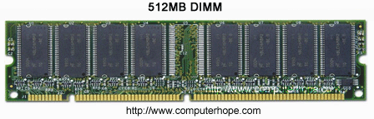
Memory (RAM):-
RAM (Random access memory) It store data that is being used currently . Accessing data stored on the ram is much quicker that directly accessing data stored on the hard disk allowing a computer much faster

Slide 3
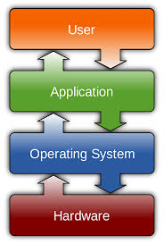
File System
A file system is the methods and data structures that an operating system uses to keep track of files on a disk or partition. That is the way the files are organized on the disk.

Slide 4
why we use 1000 instead of 1024 ?
Why we use 1000 instead of 1024 because ("kilo" means 1000)(10^3).
In most cases, this approximation is fine for determining how much space a file takes up or how much disk space you have. But there are really 1024 bytes in a kilobyte. The reason for this is because computers are based on the binary system.

Slide 5
ASCII
Acronym for the American Standard Code for Information Interchange. Pronounced ask-ee, ASCII is a code for representing English characters as numbers, with each letter assigned a number from 0 to 127. ... Most computers use ASCII codes to represent text
ASCII value for (A) is 65 and goes on.
ASCII value for (a) is 97 and goes on.

Slide 6
Data Types
Data Types | Bytes | Other Names | Range
byte | 1 byte | Signed Unsigned | -128 to 127 0 to 255
Short | 2 bytes | Signed Unsigned | -32768 to 32767 0 to 65535
int | 4 bytes | Signed Unsigned | -2147483648 to 214783647 0 to 4,294,967,295
long | 4 bytes | Signed Unsigned | -2147483648 to 214783647 0 to 4,294,967,295

